Slide 1
Binary Search

Slide 2
Binary Search
Binary Search is a searching algorithm for finding an element's position in a sorted array.
In this approach, the element is always searched in the middle of a portion of an array.
Note:
Binary search can be implemented only on a sorted list of items. If the elements are not sorted already, we need to sort them first.

Slide 3
Binary Search
Binary Search Algorithm can be implemented in two ways which are discussed below.
Iterative Method
Recursive Method
The recursive method follows the divide and conquer approach.
The general steps for both methods are discussed below.
The array in which searching is to be performed is:

Slide 4
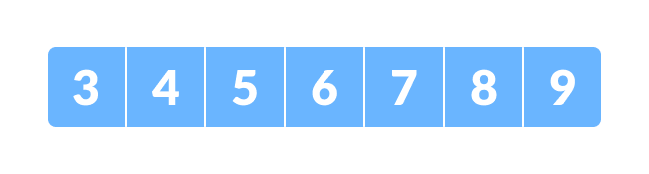
Binary Search
The general steps for both methods are discussed below.
The array in which searching is to be performed is:
Initial array

Slide 5
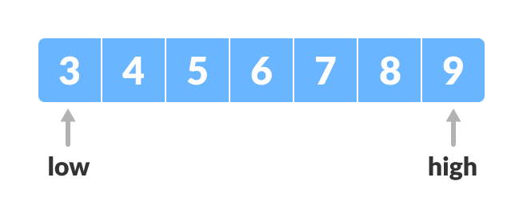
Binary Search
Let x = 4 be the element to be searched.
Set two pointers low and high at the lowest and the highest positions respectively
Setting pointers

Slide 6
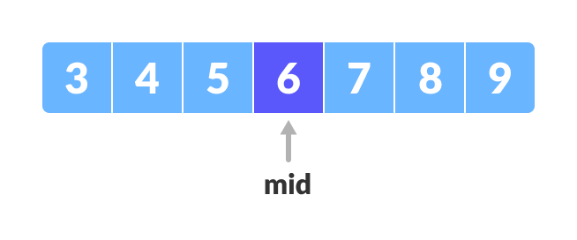
Binary Search
3. Find the middle element mid of the array ie. arr[(low + high)/2] = 6.
Mid element

Slide 7
Binary Search
4. If x == mid, then return mid. Else, compare the element to be searched with m.
5.If x > mid, compare x with the middle element of the elements on the right side of mid. This is done by setting low to low = mid + 1.
6.Else, compare x with the middle element of the elements on the left side of mid. This is done by setting high to high = mid - 1.

Slide 8
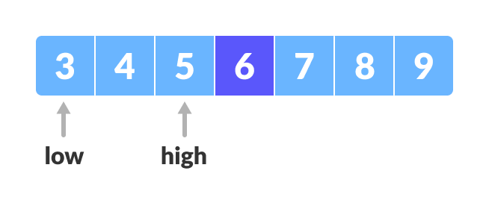
Binary Search
Finding mid element
Repeat steps 3 to 6 until low meets high.

Slide 9
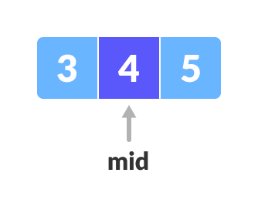
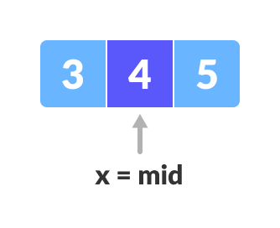
Binary Search
X = 4 is Found

Slide 10
Binary Search
Binary Search Algorithm: Iteration Method
do until the pointers low and high meet each other.
mid = (low + high)/2
if (x == arr[mid])
return mid
elif (x > arr[mid]) // x is on the right side
low = mid + 1
else // x is on the left side
high = mid - 1

Slide 11
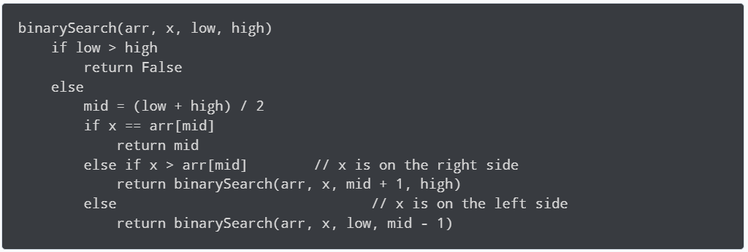
Binary Search
Binary Search Algorithm: Recursive Method

Slide 12
Binary Search
array = [3, 4, 5, 6, 7, 8, 9]
x = 4
result = binarySearch(array, x, 0, len(array)-1)
if result != -1:
print("Element is present at index " + str(result))
else:
print("Not found")
# Binary Search in python
def binarySearch(array, x, low, high):
while low <= high:
mid = low + (high - low)//2
if array[mid] == x:
return mid
elif array[mid] < x:
low = mid + 1
else:
high = mid - 1
return -1

